Slide 1
Distilling the Knowledge in a Neural Network
Geoffrey Hinton, Oriol Vinyals, Jeff Dean

Slide 2
Motivation
Deploying large model to a large number of users will be extremely computationally expensive, The ability to ensemble the knowledge from large model to a relatively small model is important in practical use of models.

Slide 3
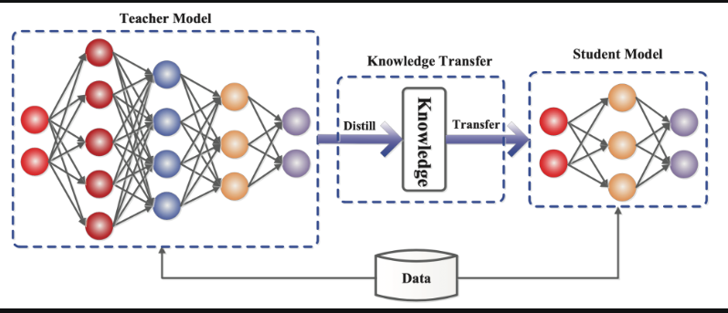
Knowledge Distillation

Slide 4
Principal Components
The Knowledge
The Distillation Algorithm
The teacher-student architecture

Slide 5
The Knowledge
Response-based knowledge
final output layer of the teacher model (soft targets / soft labels)

Slide 6
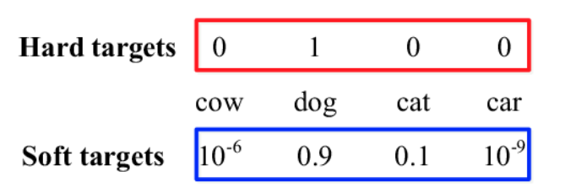
Soft Targets / Soft Labels

Slide 7
The Distillation Algorithm
Offline distillation
the teacher model is first pre-trained on a training dataset, and then knowledge from the teacher model is distilled to train the student model.

Slide 8
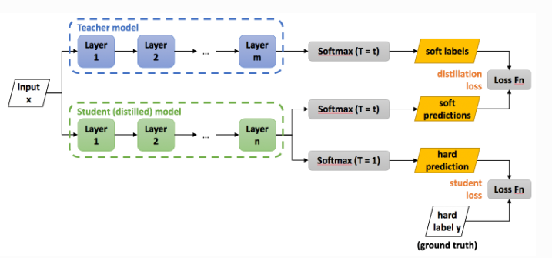
The teacher-student architecture
Offline Distillation:
a shallower version of the teacher model with fewer layers and fewer neurons per layer

Slide 9
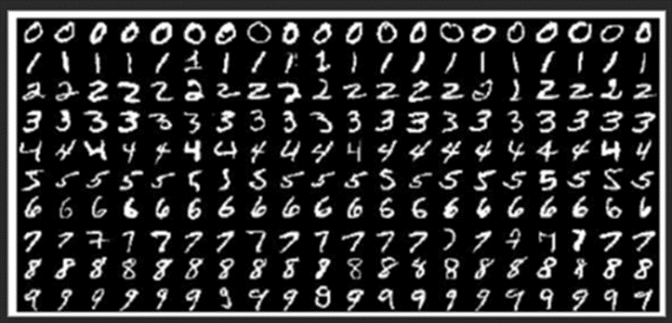
Dataset MNIST
The MNIST database of handwritten digits has a training set of 60,000 examples, and a test set of 10,000 examples.
MNIST Dataset | Kaggle

Slide 10
Experiment
Teacher Model:
large neural net with two hidden layers of 1200 rectified linear hidden units on all 60,000 training cases
Student Model:
two hidden layers of 800 rectified linear hidden units
Result:
Teacher net achieved 67 test errors whereas a smaller net achieved 146 errors.

